Slide 1
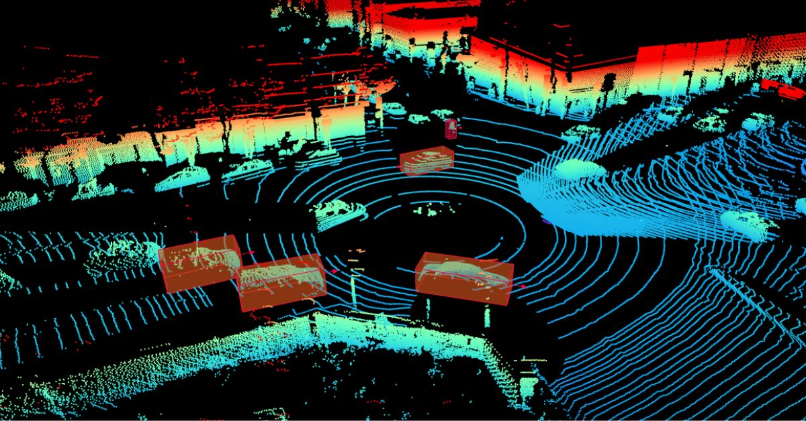
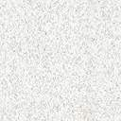
3D Point Cloud Visualization

Slide 2
Tools & libraries for Point Cloud Visualization
1.Open3D: A powerful open-source library for 3D data processing and point cloud visualization.
https://www.open3d.org/
2. MeshLab: An open-source tool for processing and editing 3D triangular meshes and point clouds.
https://www.meshlab.net/
3. Unity 3D: A game development platform that can be used for interactive point cloud visualization.
https://unity.com/
4. PCL (Point Cloud Library): An open-source library for point cloud processing and visualization.
https://pointclouds.org/
5. Matplotlib: A open-source library can be used for basic point cloud visualization.
https://matplotlib.org/

Slide 3
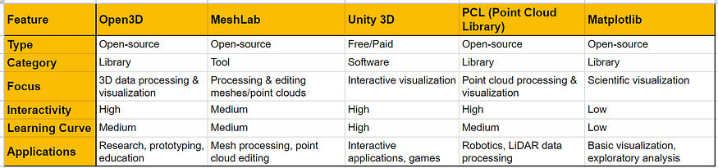
Tools & libraries for Point Cloud Visualization

Slide 4
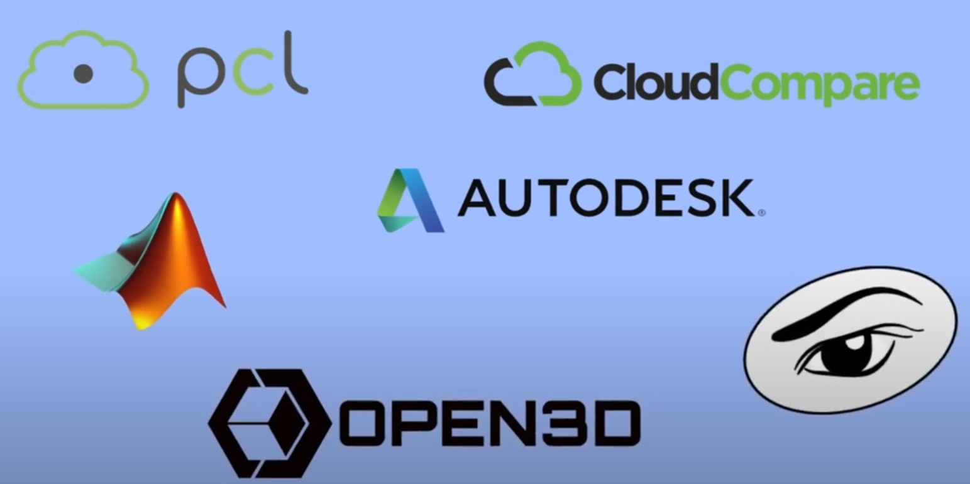
Tools for visualizing pcloud data

Slide 5


Slide 6
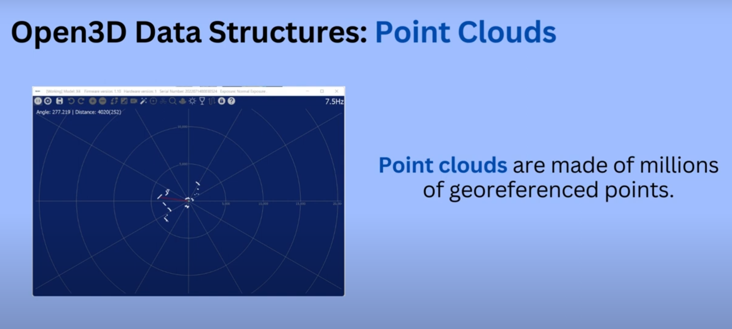

Slide 7
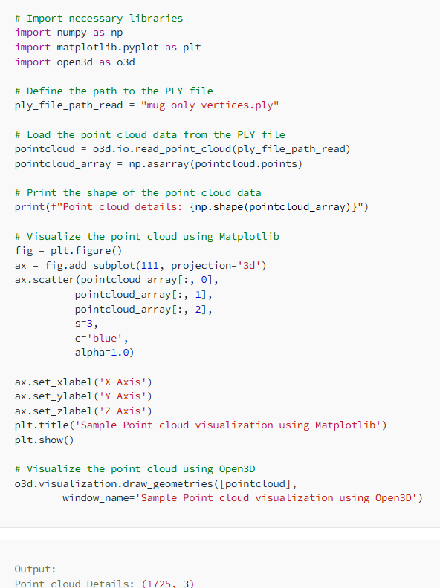
The “mug-only-vertices.ply” file can be download from https://github.com/MatPixel/dataset-for-3d-pointcloud-processing-3d-deep-learning/blob/main/mug-only-vertices.ply

Slide 8
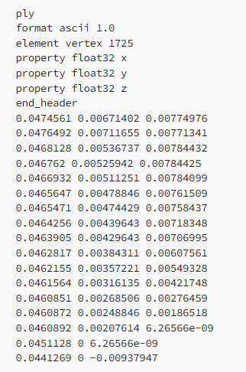
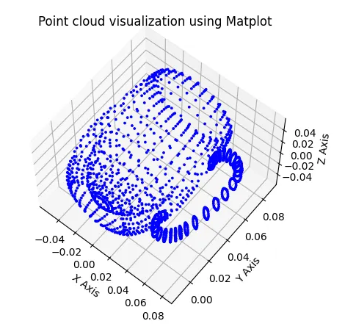
Visualization using Matplotlib

Slide 9
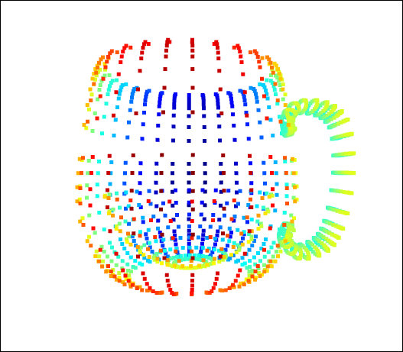
Visualization using Open3D

Slide 10
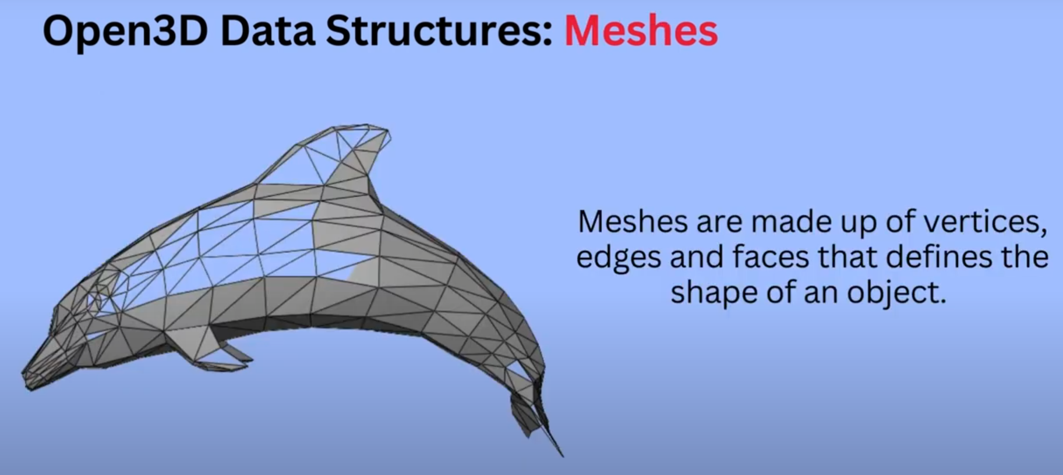

Slide 11
PCD to Mesh Conversion
WHY?
Surface Reconstruction: Point clouds are collections of discrete points in 3D space, which can be irregularly sampled. Converting them to a mesh creates a continuous surface representation, making it easier to visualize and analyze.
Visualization: Meshes offer smoother and visually appealing representations, ideal for 3D graphics and simulation applications.
Computational Geometry: Meshes simplify geometric algorithms like collision detection and ray tracing, making them more efficient than point clouds.

Slide 12
PCD to Mesh Conversion
WHY NOT?
Increased Complexity: Meshes have more complex data structures, making some operations more challenging.
Mesh Artifacts: Meshes can have artifacts like gaps or non-manifold geometry, depending on the reconstruction method.
Information Loss: Converting to meshes can lose fine-grained details from the original point cloud.

Slide 13
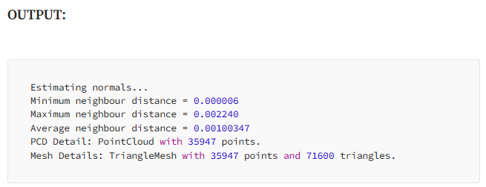
PCD to Mesh Conversion: CODE
# Import libraries
import numpy as np
import open3d as o3d
# Load a point cloud
ply_file_path_read = "bunny-pcd.ply"
point_cloud = o3d.io.read_point_cloud(ply_file_path_read)
# Compute normals if PCD does not have
if point_cloud.has_normals() == False:
print("Estimating normals...")
point_cloud.estimate_normals()
else:
print("PCD already has normals. So, skip estimating normals")
# Orient the computed normals w.r.t to the tangent plane.
# This step will solve the normal direction issue. If this step is skipped, there might be holes in the mesh surfaces.
o3d.geometry.PointCloud.orient_normals_consistent_tangent_plane(point_cloud, 10)
# Estimate radius for rolling ball
distances = point_cloud.compute_nearest_neighbor_distance()
avg_dist = np.mean(distances)
radius = 1.5 * avg_dist
print("Minimum neighbour distance = {:.6f}".format(np.min(distances)))
print("Maximum neighbour distance = {:.6f}".format(np.max(distances)))
print("Average neighbour distance = {:.6f}".format(np.mean(distances)))
mesh = o3d.geometry.TriangleMesh.create_from_point_cloud_ball_pivoting(
point_cloud,
o3d.utility.DoubleVector([radius, radius * 2]))
print("PCD Detail: {}".format(point_cloud))
print("Mesh Details: {}".format(mesh))
# Visualize and save the mesh generated from point cloud
#mesh.paint_uniform_color(np.array([0.5, 1.0, 0.5])) # to uniformly color the surface
o3d.visualization.draw_geometries([mesh], window_name='mesh with estimated normals', width=1200, height=800)
o3d.io.write_triangle_mesh("bunny-pcd-to-mesh.ply", mesh, write_ascii=True)

Slide 14
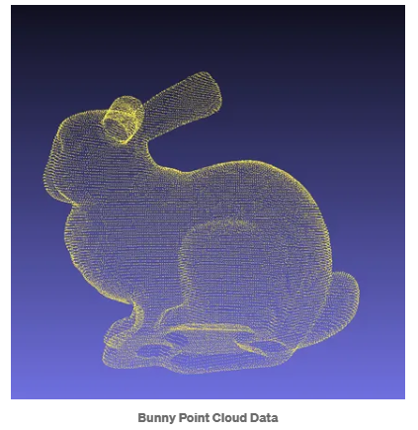
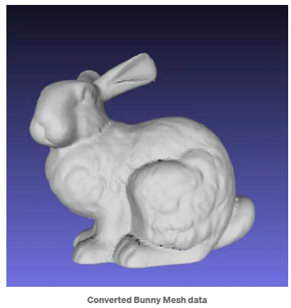
The output

Slide 15
PCD to Voxel Grid Conversion
WHY?
Regularization: Point clouds are often irregularly sampled. Converting them to a voxel grid imposes a regular structure, providing a more organized and standardized representation of the 3D space.
Quantization: Voxel grids quantize the 3D space into small cubes (voxels). This simplifies spatial indexing, allowing for efficient and uniform data processing.
Resampling: Voxel grids enable uniform resampling of the 3D space, allowing you to change the voxel size to control data resolution.
Medical Imaging: Voxel grids are used in medical imaging for representing volumetric data, such as CT scans and MRI images.

Slide 16
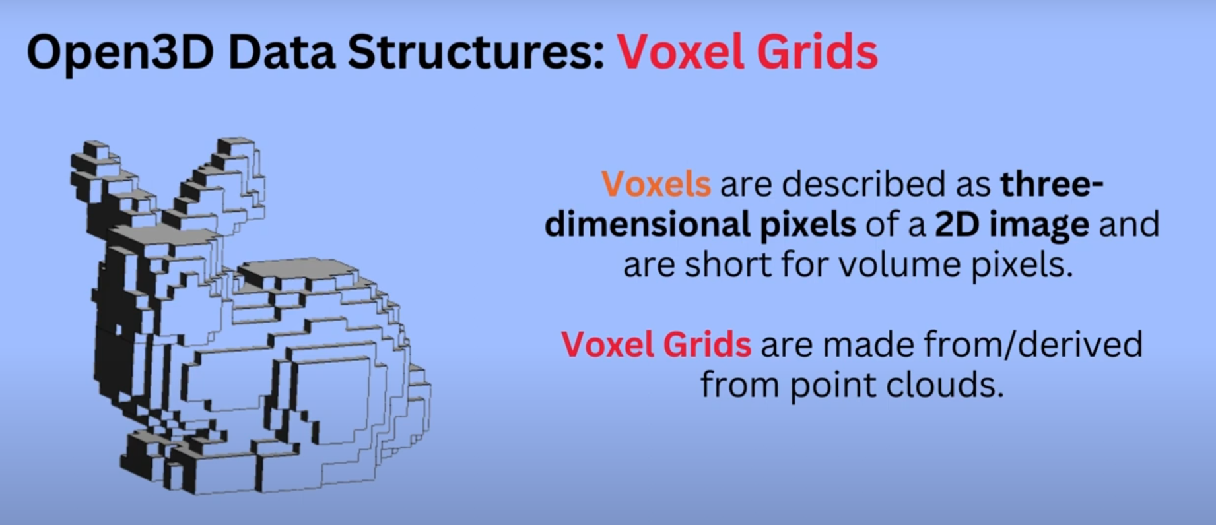

Slide 17
PCD to Voxel Grid Conversion
WHY NOT?
Complexity: Voxel grids introduce additional data structures and indexing mechanisms, increasing computational complexity for certain operations.
Information Loss: Fine-grained details present in the original point cloud can be lost depending on the voxel size.

Slide 18
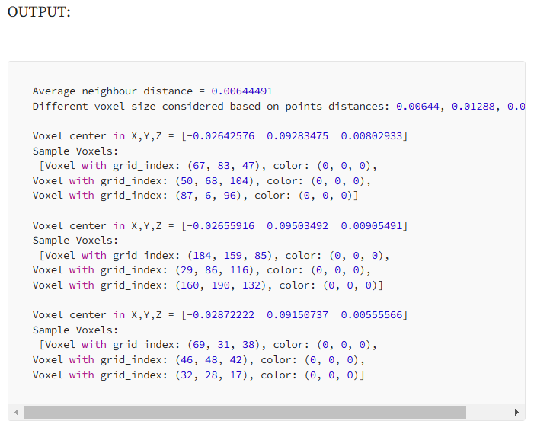
PCD to Voxel Grid Conversion
# Import libraries
import numpy as np
import open3d as o3d
# Load a point cloud
ply_file_path_read = "bunny-pcd.ply"
point_cloud = o3d.io.read_point_cloud(ply_file_path_read)
#point_cloud = point_cloud.uniform_down_sample(every_k_points=10) # if there are huge points
point_cloud.scale(1 / np.max(point_cloud.get_max_bound() - point_cloud.get_min_bound()),center=point_cloud.get_center()) # Fit to unit cube
o3d.io.write_point_cloud("bunny-pcd-unitcube.ply", point_cloud, write_ascii=True)
# Estimate radius for rolling ball
distances = point_cloud.compute_nearest_neighbor_distance()
avg_dist = np.mean(distances)
print(f"Average neighbour distance = {np.mean(distances):.6}")
# Guess different voxel sizes based on points' distances
voxelsize = np.round(avg_dist, 5)
voxelsize_half = voxelsize/2
voxelsize_double = voxelsize*2
print(f"Different voxel size considered based on points' distances: {voxelsize}, {voxelsize_double}, {voxelsize_half}")
voxel_grid = o3d.geometry.VoxelGrid.create_from_point_cloud(point_cloud, voxel_size=voxelsize)
print(f"Voxel center in X,Y,Z = {voxel_grid.get_center()}")
print(f"Sample Voxels: \n {voxel_grid.get_voxels()[:3]}")
o3d.visualization.draw_geometries([voxel_grid], width=1200, height=800)
o3d.io.write_voxel_grid("bunny-pcd-to-voxel-001-unitcube.ply", voxel_grid, write_ascii=True)
voxel_grid = o3d.geometry.VoxelGrid.create_from_point_cloud(point_cloud, voxel_size=voxelsize_half)
o3d.visualization.draw_geometries([voxel_grid], width=1200, height=800)
o3d.io.write_voxel_grid("bunny-pcd-to-voxel-002-unitcube.ply", voxel_grid, write_ascii=True)
print(f"Voxel center in X,Y,Z = {voxel_grid.get_center()}")
print(f"Sample Voxels: \n {voxel_grid.get_voxels()[:3]}")
voxel_grid = o3d.geometry.VoxelGrid.create_from_point_cloud(point_cloud, voxel_size=voxelsize_double)
o3d.visualization.draw_geometries([voxel_grid], width=1200, height=800)
o3d.io.write_voxel_grid("bunny-pcd-to-voxel-003-unitcube.ply", voxel_grid, write_ascii=True)
print(f"Voxel center in X,Y,Z = {voxel_grid.get_center()}")
print(f"Sample Voxels: \n {voxel_grid.get_voxels()[:3]}")

Slide 19
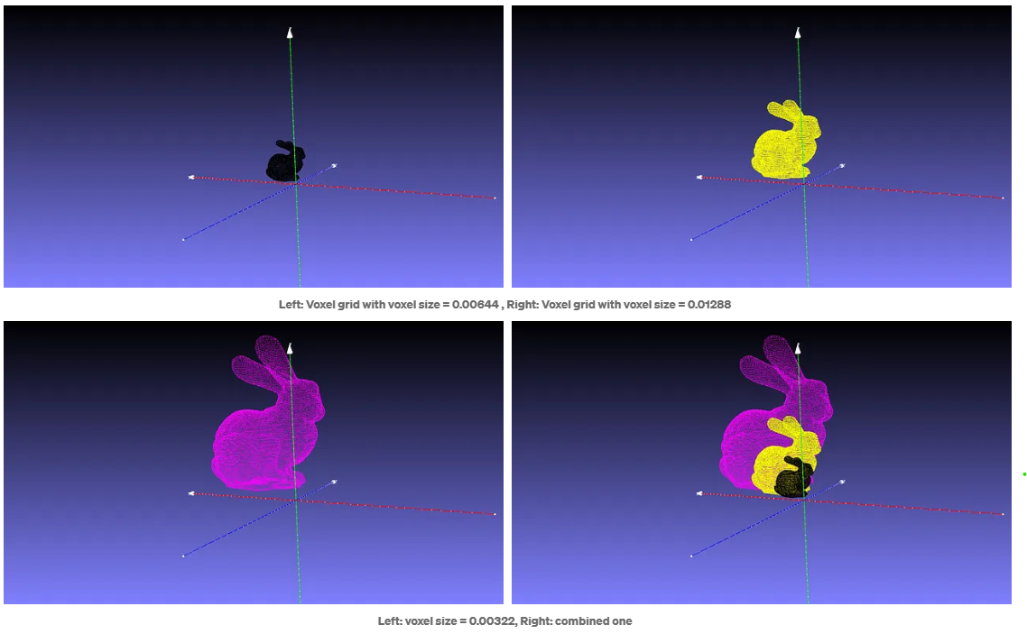
PCD to Voxel Grid Conversion
Plots from left to right and top to bottom: voxel grid with voxel size = 0.00644, 0.01288, 0.00322 and the combined one respectively.

Slide 20
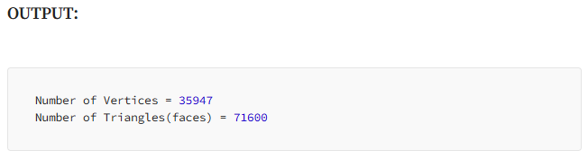
Visualizing 3D meshes
# Import libraries
import numpy as np
import open3d as o3d
# Load a mesh
ply_file_path_read = "bunny-mesh.ply"
mesh = o3d.io.read_triangle_mesh(ply_file_path_read)
mesh.compute_vertex_normals()
#mesh.scale(1 / np.max(mesh.get_max_bound() - mesh.get_min_bound()),center=mesh.get_center()) # Fit to unit cube
print(f"Number of Vertices = {len(np.asarray(mesh.vertices))}")
print(f"Number of Triangales(faces) = {len(np.asarray(mesh.triangles))}")
# Convert mesh to pcd
points = mesh.vertices
point_cloud = o3d.geometry.PointCloud(points)
# Visualize and save the point cloud
o3d.visualization.draw_geometries([point_cloud], width=1200, height=800)
o3d.io.write_point_cloud("bunny-mesh-to-pcd.ply", point_cloud, write_ascii=True)
From the above code, the commented line is meant to make the mesh fit into a unit cube by scaling around the center. This step is often used in real-time projects where multiple meshes are involved for processing.
#mesh.scale(1 / np.max(mesh.get_max_bound() - mesh.get_min_bound()),center=mesh.get_center()) # Fit to unit cube

Slide 21
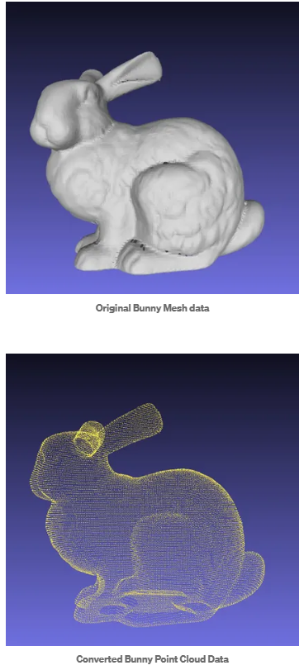
Meshes to PCD Conversion

Slide 22
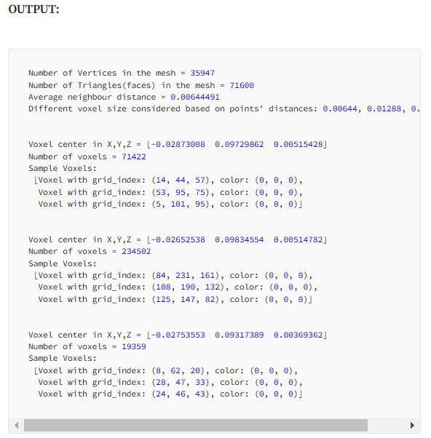
Meshes to Voxel Grid
# Import libraries
import numpy as np
import open3d as o3d
# Load a mesh
ply_file_path_read = "bunny-mesh.ply"
mesh = o3d.io.read_triangle_mesh(ply_file_path_read)
mesh.compute_vertex_normals()
mesh.scale(1 / np.max(mesh.get_max_bound() - mesh.get_min_bound()),center=mesh.get_center()) # Fit to unit cube
print(f"Number of Vertices in the mesh = {len(np.asarray(mesh.vertices))}")
print(f"Number of Triangles(faces) in the mesh = {len(np.asarray(mesh.triangles))}")
o3d.io.write_triangle_mesh("bunny-mesh-unitcube.ply", mesh, write_ascii=True)
# Compute points distances
pcd = o3d.geometry.PointCloud()
pcd.points = o3d.utility.Vector3dVector(mesh.vertices)
distances = pcd.compute_nearest_neighbor_distance()
avg_dist = np.mean(distances)
print(f"Average neighbour distance = {np.mean(distances):.6}")
# Guess different voxel sizes based on points' distances (KDTree approach also can be used)
voxelsize = np.round(avg_dist, 5)
voxelsize_half = voxelsize/2
voxelsize_double = voxelsize*2
print(f"Different voxel size considered based on points' distances: {voxelsize}, {voxelsize_double}, {voxelsize_half}")
# Convert mesh to pcd
voxel_grid = o3d.geometry.VoxelGrid.create_from_triangle_mesh(mesh, voxel_size=voxelsize)
print(f"Voxel center in X,Y,Z = {voxel_grid.get_center()}")
print(f"Number of voxels = {len(np.asarray(voxel_grid.get_voxels()))}")
print(f"Sample Voxels: \n {voxel_grid.get_voxels()[:3]}")
o3d.visualization.draw_geometries([voxel_grid], width=1200, height=800)
o3d.io.write_voxel_grid("bunny-mesh-to-voxel-001-unitcube.ply", voxel_grid, write_ascii=True)
voxel_grid = o3d.geometry.VoxelGrid.create_from_triangle_mesh(mesh, voxel_size=voxelsize_half)
print(f"Voxel center in X,Y,Z = {voxel_grid.get_center()}")
print(f"Number of voxels = {len(np.asarray(voxel_grid.get_voxels()))}")
print(f"Sample Voxels: \n {voxel_grid.get_voxels()[:3]}")
o3d.visualization.draw_geometries([voxel_grid], width=1200, height=800)
o3d.io.write_voxel_grid("bunny-mesh-to-voxel-002-unitcube.ply", voxel_grid, write_ascii=True)
voxel_grid = o3d.geometry.VoxelGrid.create_from_triangle_mesh(mesh, voxel_size=voxelsize_double)
print(f"Voxel center in X,Y,Z = {voxel_grid.get_center()}")
print(f"Number of voxels = {len(np.asarray(voxel_grid.get_voxels()))}")
print(f"Sample Voxels: \n {voxel_grid.get_voxels()[:3]}")
o3d.visualization.draw_geometries([voxel_grid], width=1200, height=800)
o3d.io.write_voxel_grid("bunny-mesh-to-voxel-003-unitcube.ply", voxel_grid, write_ascii=True)

Slide 23
